Slide 1
Smart Spreading Factor Assignment for LoRaWANs
Tuğrul Yatağan
yatagan@itu.edu.tr
Thesis Advisor: Prof. Dr. Sema Fatma Oktuğ
Notes:
Hello everyone I am going to present my master thesis “Smart Spreading Factor Assignment for LoRaWANs”

Slide 2
Outline
Introduction
LoRa
Related Works
Proposed Technique
Simulation Environment
Simulation Results
Conclusion
Notes:
I will start with brief information about LPWAN
Then I will give background information about LoRa and LoRaWAN
I will summarize other recent related works
I will describe proposed smart spreading factor assignment technique
I will explain simulation environment
I will show simulation results

Slide 3
Introduction
LoRa
Related Works
Proposed Technique
Simulation Environment
Simulation Results
Conclusion
Introduction: LPWAN Overview
Number of Internet of Things applications increased exponentially in last few years
How to provide connectivity for low power devices distributed over large geographical areas?
Example LPWA application areas:
Smart city
Industrial assets monitoring
Smart grid metering
Agriculture
Logistic
Notes:
I will start with explaining lpwan
Number of Internet of Things applications increased exponentially in last few years
How to provide connectivity for low power devices distributed over large geographical areas? Lpwan technologies answer this question
Such LPWAN applications are:
Smart city
Industrial assets monitoring
Smart grid metering
Agriculture
Logistic
Etc.

Slide 4
Introduction
LoRa
Related Works
Proposed Technique
Simulation Environment
Simulation Results
Conclusion
Introduction: LPWAN Overview
Key challenges:
Communication range
Tens of kilometers
Device battery life
Up to 10 years of battery life with a single AA battery
Scalability
Hundreds of end devices
Device cost
Affordable radio chip
Low subscription cost
Notes:
What are the key challenges of lpwan technologies?
they are expected to achieve tens of kilometers communication range
they are expected to run up to 10 years of battery life with a single AA battery
they should be able to support and operate hundreds of end devices
And the end device cost should be low, subscription cost should be low too if there is any subscription costs

Slide 5
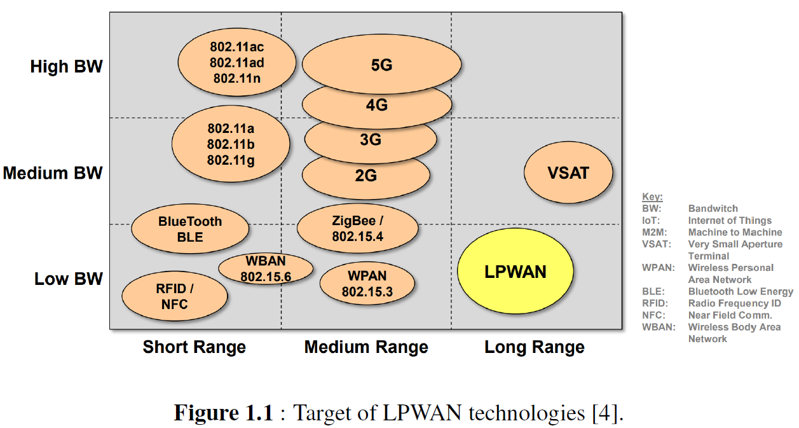
Introduction
LoRa
Related Works
Proposed Technique
Simulation Environment
Simulation Results
Conclusion
Introduction: LPWAN Overview
LPWAN fills the technology gap between:
Short range wireless technologies (ZigBee, Bluetooth, WiFi)
Range is limited to a few hundred meters at best
Very costly to deploy dense network
Cellular (2G, 3G, LTE)
Optimized for voice and data
Complex and expensive
High power consumption
Notes:
LPWAN technologies aims to fill the technology gap between short range wireless technologies such as ZigBee, Bluetooth, WiFi and Cellular networks such as 2G, 3G and LTE
Short range wireless technologies
range is limited to a few hundred meters at best
And they are very costly to deploy for dense networks
Cellular networks
are optimized for voice and data
They are complex and expensive
They consume too much power

Slide 6
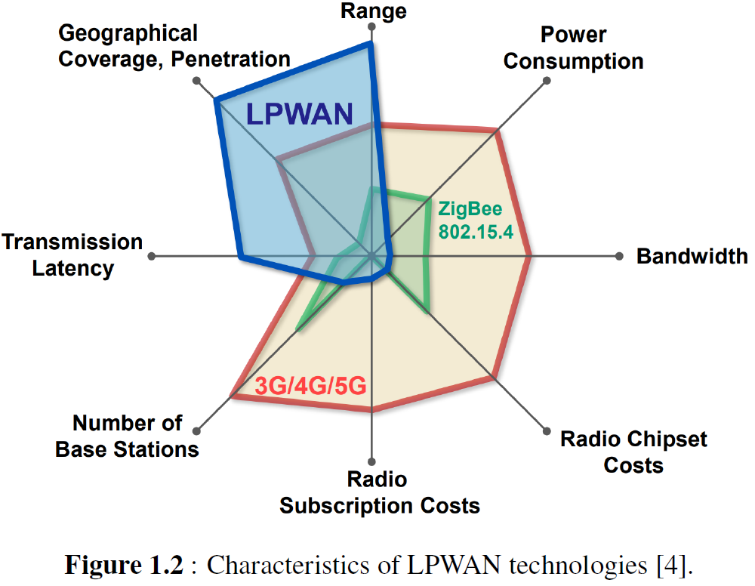
Introduction
LoRa
Related Works
Proposed Technique
Simulation Environment
Simulation Results
Conclusion
Introduction: LPWAN Key Features
Low power wide area networks:
Low power
Long range
Low cost
Low data rate
High latency
LPWAN applicable applications:
Delay tolerant
Low data rate
Low power consumption
Low cost
Notes:
LPWAN technologies offer
Low power
Long range
And low cost
However they cannot provide high data rate or low latency
To use lpwan, applications should be
Delay tolerant
Low data rate
Low power consumption
Low cost
LPWAN is not suitable for many industrial IoT, vehicle to vehicle since they require low latency

Slide 7
Introduction
LoRa
Related Works
Proposed Technique
Simulation Environment
Simulation Results
Conclusion
Introduction: LPWAN Key Features
Several competing LPWAN technologies:
LoRa
Sigfox
NB-IoT
LTE-M
Notes:
There are several competing LPWAN technologies well know lpwan technologies are LoRa Sigfox NB-IoT LTE-M
LoRa and Sigfox use license free ISM frequency bands
While NB-IoT and LTE-M use licensed frequency bands which brings extra cost
Both LoRa and Sigfox are known for ultra-low power consumption
While NB-IoT and LTE-M are promoted for higher data rate
LoRaWAN networks can be deployed as a private network like WiFi
However, Sigfox and NB-IoT are only available with operator contract
Focus of this work is on lora

Slide 8
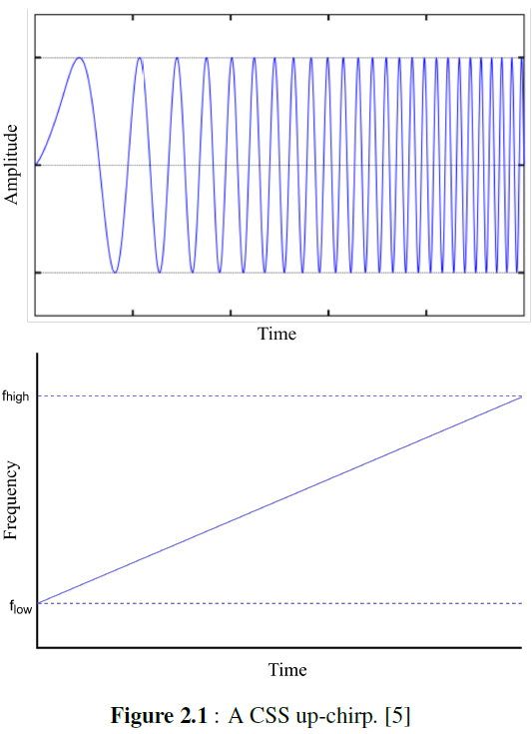
Introduction
LoRa
Related Works
Proposed Technique
Simulation Environment
Simulation Results
Conclusion
LoRa: Modulation
LoRa modulates the signals in Sub-GHz ISM band using a proprietary modulation technique based on Chirp Spread Spectrum
Resilient to interference and noise
Chirp is a sinusoidal signal of frequency increase or decrease over time
The direction of the scan determines the transmission symbol
The speed of the scan is called the spreading factor (SF)
Higher SF:
Lower data rate
Longer transmission duration
Higher power consumption
Higher resilience to noise
Longer transmission range
Notes:
LoRa modulates the signals in Sub-GHz ISM band using a proprietary modulation technique based on Chirp Spread Spectrum
It is resilient to interference and noise
Chirp is a sinusoidal signal which its frequency increases or decreases over time
The direction of the scan determines the transmission symbol
And The speed of the scan is called the spreading factor
increasing spreading factor:
decreases data rate
increases transmission duration
increases power consumption
However it makes the signal more resilience to noise
Increases transmission range

Slide 9
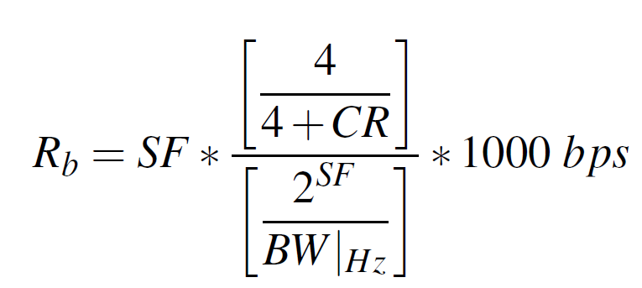
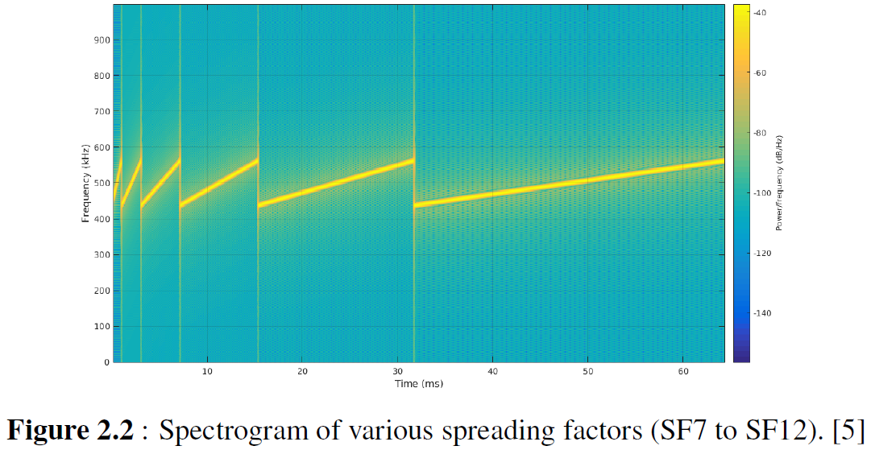
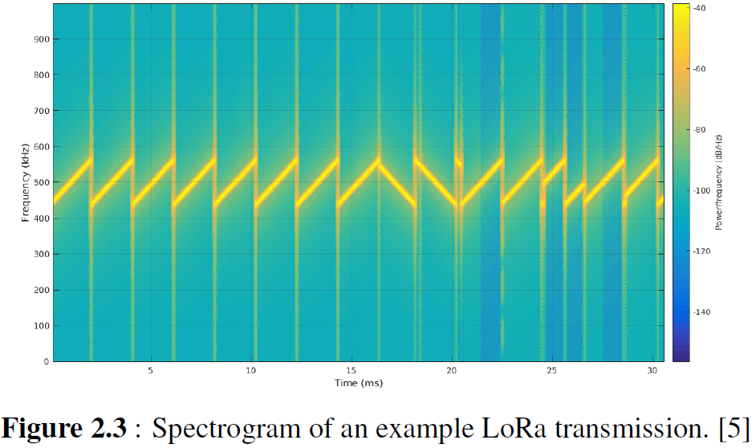
Introduction
LoRa
Related Works
Proposed Technique
Simulation Environment
Simulation Results
Conclusion
LoRa: Spreading Factor
Ratio between symbol and chirp rate is equal to 2^{SF}
SF can take values between 7 and 12
SF provides tradeoff between data rate, range and power consumption
Notes:
The ratio between symbol and chirp rate is equal to 2^{SF}
Spreading factor also determines data rate of a LoRa transmission
Here Rb is bit rate in bps, SF is spreading factor, CR is error correction code rate BW is bandwidth in Hertz
SF can take values between 7 and 12
CR can take values between 1 and 4
When bandwidth and code rate are constant as the spreading factor increases, the data rate decreases
Higher spreading factors delivers long range at an expense of lower data rate and high power consumption

Slide 10
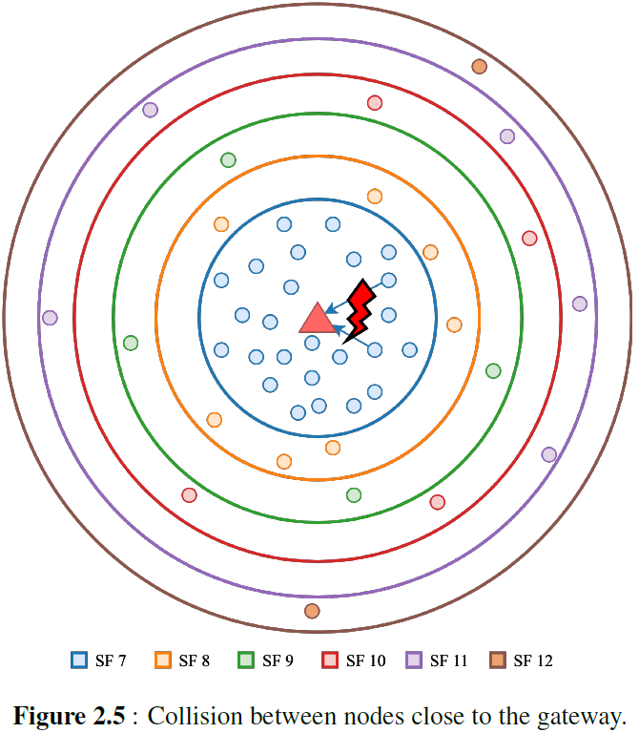
Introduction
LoRa
Related Works
Proposed Technique
Simulation Environment
Simulation Results
Conclusion
LoRa: Spreading Factor Assignment Issue
Different SF transmissions are orthogonal to each other
Packets with different SFs in same channel can be received simultaneously
Simultaneous transmissions with same SF may collide
End nodes select SF according to signal strength of the downlink transmission from GW
End nodes which close to the GW will probably select the lowest SF all the time
Same SF transmission collision
Number of collisions increases while number of end devices close to the GW increases
Notes:
Simultaneous different spreading factor transmissions are orthogonal to each other
Which means gateway can simultaneously receive multiple transmissions with different spreading factors
But simultaneous transmissions with the same spreading factor may not be received due to collision
initially, a node is not aware of how far away it is from a gateway. However, it can guess by observing received signal power of a downlink transmission
End nodes which close to the gateway will probably select the lowest spreading factor all the time which results
Same spreading factor transmission collisions
collisions increases while number of end devices close to the gateway increases

Slide 11
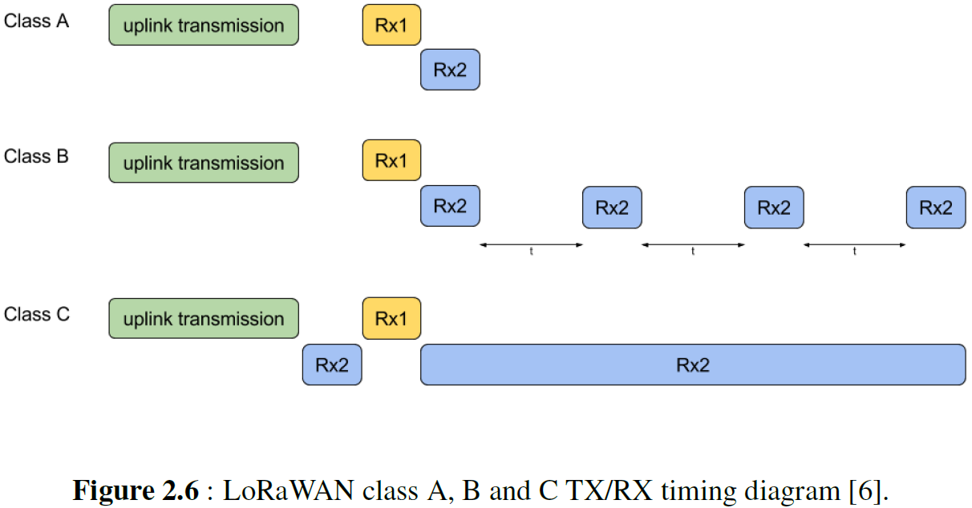
Introduction
LoRa
Related Works
Proposed Technique
Simulation Environment
Simulation Results
Conclusion
LoRa: LoRaWAN
LoRaWAN is open standard MAC layer protocol for LoRa physical layer, developed by LoRa Alliance
End Node (EN)
Low power embedded device that only communicates with gateways
Class A
Generates uplink transmission at any time
Only receives a period of time after an uplink transmission
Default operation mode
Suitable for battery powered applications
Class B
Periodic receive window
Suitable for low latency applications
Class C
Continuous receive window
Suitable for no latency applications
Notes:
LoRa has an open standard MAC layer protocol called LoRaWAN
LoRaWAN is developed and maintained by LoRa Alliance which is an non-profit organization
There are three main LoRaWAN network entities, which are end node, gateway and network server
End node is a low power embedded device that only communicates with gateways
LoRaWAN standard defines three classes for end devices
Class A end nodes generate uplink transmission at any time
And Only receives a period of time after an uplink transmission
Class A is the default operation mode for end nodes
Class B end nodes extend Class A behavior by adding scheduled periodic receive windows
Class C end nodes extend Class A behavior by keeping receive window open all the time
In this thesis, only Class A end devices are considered since Class A behavior leads to the lowest power consumption and Class A is the default operation mode.

Slide 12
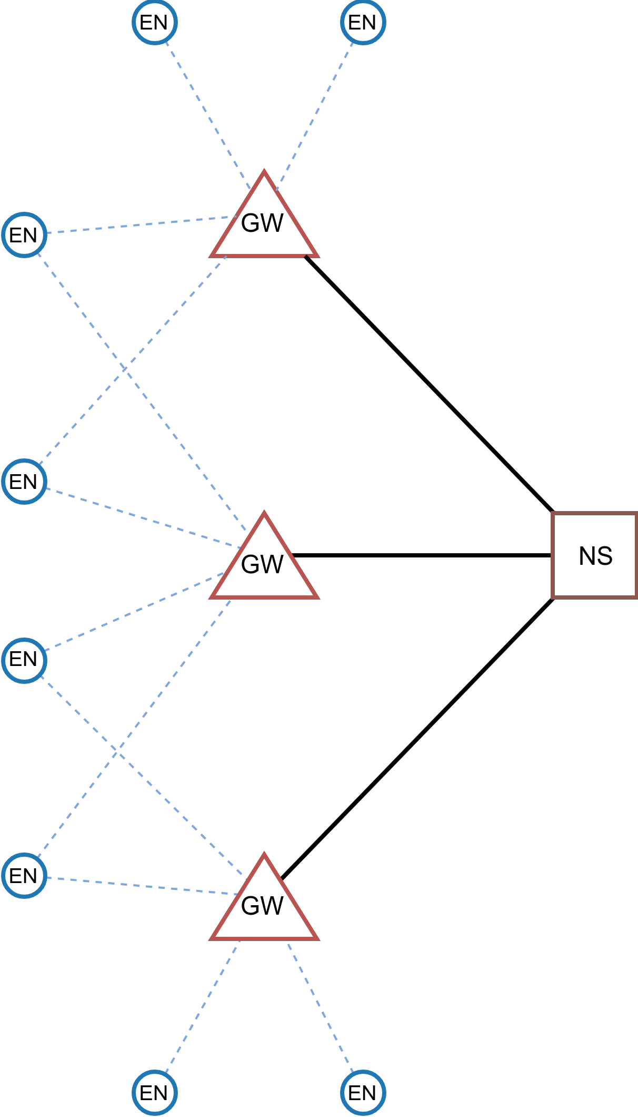
Introduction
LoRa
Related Works
Proposed Technique
Simulation Environment
Simulation Results
Conclusion
LoRa: LoRaWAN
Gateway (GW)
Receive/transmit packets coming from/to end nodes
Can listen multiple channel at the same time
Network Server (NS)
Brain of the LoRaWAN network
Routes messages from application to end nodes
Process hungry calculations and applications such as triangulation
Can tweak communication parameters of nodes such as SF and TX power
Adaptive Data Rate (ADR)
ADR implementation is left to the network operators
Figure 2.7: LoRaWAN star of stars network architecture.
Notes:
Next entity is gateway
gateway receives packets coming from end nodes
gateway can receive from multiple channels at the same time.
Gateways are usually connected to power grid, so power consumption of a gateway is not critical
Network Server is the brain of the LoRaWAN network
It routes messages from application to end nodes
Process hungry calculations and applications can be run in NS such as triangulation
Network server can tweak communication parameters of nodes such as spreading factor and transmit power
This is done by Adaptive Data Rate mechanism
If ADR is enabled, then spreading factor of the end node’s are controlled by the NS.
But The ADR algorithm is not defined in LoRaWAN protocol.
They define the protocol but leave ADR algorithm to the network operators.

Slide 13
Introduction
LoRa
Related Works
Proposed Technique
Simulation Environment
Simulation Results
Conclusion
LoRa: LoRaWAN
Messages transmitted by end nodes are received by all GWs in range
Star of stars
No direct communication between end nodes
No forwarding between end nodes
Simplify the design of end devices
Move complexity to backend system
Pure ALOHA medium access
End nodes do not check whether the channel is free or not before transmission
No CSMA/CA
No waste precious energy in busy-listening to other devices
Figure 2.7: LoRaWAN star of stars network architecture.
Notes:
Messages transmitted by end nodes are received by all GWs in range
This network architecture is called as star of stars
End nodes cannot communicate with each other thus
End nodes do not make any forwarding
This architecture simplifies the design of end devices
It moves complexity to backend system
LoRaWAN adopts pure ALOHA medium access
Which means End nodes do not check whether the channel is free or not before transmission
There is no Carrier-sense multiple access with collision avoidance mechanism
End nodes do not waste precious energy by busy-listening the wireless medium

Slide 14
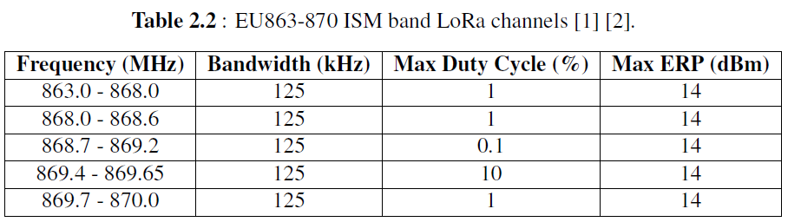
Introduction
LoRa
Related Works
Proposed Technique
Simulation Environment
Simulation Results
Conclusion
LoRa: ISM Regulations
LoRaWAN operates in license free Industrial, Scientific, and Medical (ISM) bands
ISM bands are subject to radio transmission time and power regulations
Duty cycle restriction
Limitation on percentage of air time
1% duty cycle restriction enforces
Single transmission cannot exceed 3.6 seconds
Total time on air in one hour cannot exceed 36 seconds
Effective isotropic radiated power restriction
Sets maximum allowed transmit power of a transmitter
Notes:
LoRaWAN operates in license free ISM bands.
ISM bands are subject to radio transmission time and power regulations
Duty Cycle Restriction is a limitation on percentage of air time.
For example 1% duty cycle restriction enforces
Single transmission cannot exceed 3.6 seconds
And total time on air in one hour cannot exceed 36 seconds
Effective Isotropic Radiated Power Restriction sets the maximum allowed transmit power of a transmitter

Slide 15
Introduction
LoRa
Related Works
Proposed Technique
Simulation Environment
Simulation Results
Conclusion
Related Works
“Performance Evaluation of LoRa Networks in a Smart City Scenario”
ns–3 module to study the performance of a LoRa-based IoT network in a typical urban scenario
SF assignment has great effect on LoRaWAN network performance
“Impact of LoRa Imperfect Orthogonality: Analysis of Link-Level Performance” and “Scalability Analysis of a LoRa Network under Imperfect Orthogonality”
Effects of imperfect orthogonality between different LoRa spreading factor transmissions
Aggregated co-SF and inter-SF interference power SIR distributions to capture the coverage distance from the gateway for modeling interference
Notes:
Related literature has started to grow recently
These are some of the notable related works on LoRa spreading factor assignment issue
In “Performance Evaluation of LoRa Networks in a Smart City Scenario”
Authors created a ns–3 module to study the performance of a LoRa-based IoT network in a typical urban scenario
They showed that spreading factor assignment has great effect on LoRaWAN network performance
In “Impact of LoRa Imperfect Orthogonality: Analysis of Link-Level Performance” and “Scalability Analysis of a LoRa Network under Imperfect Orthogonality”
Authors investigated Effects of imperfect orthogonality between different LoRa spreading factor transmissions

Slide 16
Introduction
LoRa
Related Works
Proposed Technique
Simulation Environment
Simulation Results
Conclusion
Related Works
“EXPLoRa: Extending the performance of LoRa by suitable spreading factor allocations”
New algorithm for spreading factor assignment in LoRaWANs
The algorithm assigns spreading factors by balancing air time of the packets in each spreading factor
The adaptive data rate (ADR) algorithm recommended by Semtech utilizes SNR of the last 20 transmissions
Selects the lowest possible SF and transmit power to maintain reliable communication between end node and gateway
Current state of the art implementation
Notes:
In “EXPLoRa: Extending the performance of LoRa by suitable spreading factor allocations”
Authors proposed new algorithms for spreading factor assignment
Proposed algorithm assigns spreading factors by balancing air time of the packets in each spreading factor
Lastly, The adaptive data rate algorithm recommended by Semtech utilizes signal to noise ratio of the last 20 transmissions
Recommended algorithm selects the lowest possible spreading factor and transmit power to maintain reliable communication between end node and gateway
It can be said that this is the current state of the art implementation
The Things Network, one of the biggest LoRaWAN networks in the world, is utilizing this algorithm for their deployed networks

Slide 17
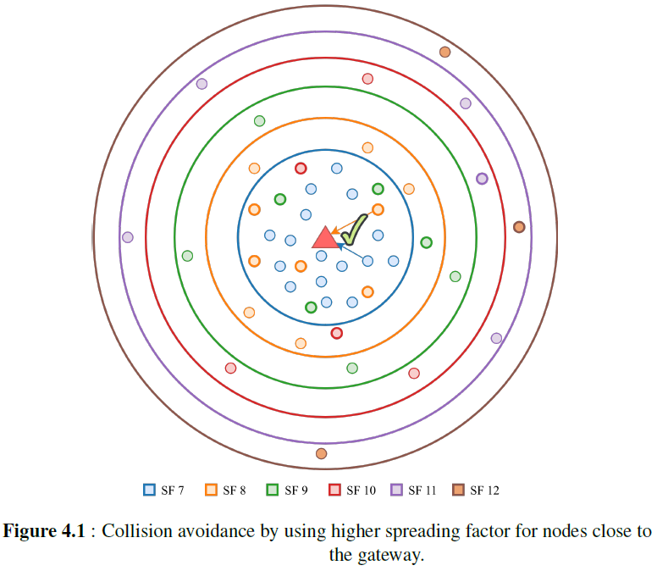
Introduction
LoRa
Related Works
Proposed Technique
Simulation Environment
Simulation Results
Conclusion
Proposed Technique: Solution
Network server can force some of close end nodes to select higher SF
Number of collision may decrease due to the orthogonality of different SF
However, higher SF:
Higher time on air
Prone to collision with other higher SF transmissions
Notes:
The collision problem I mentioned previously can be solved by forcing some of the close nodes to select higher spreading factors even they are able to communicate with lower spreading factors
Number of collision may decrease due to the orthogonality of different spreading factor
However, higher spreading factor means
Higher time on air
And this will increase the probability of collisions with other high spreading factor transmission

Slide 18
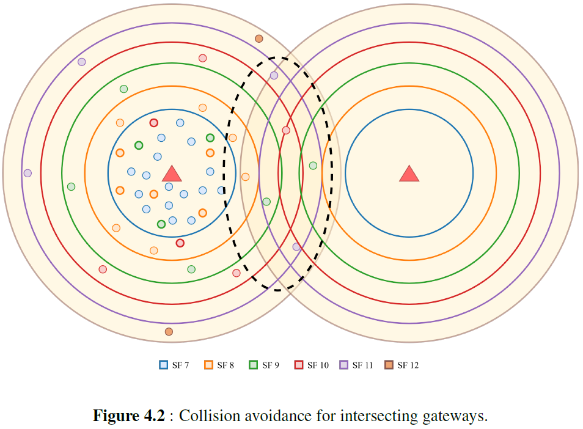
Introduction
LoRa
Related Works
Proposed Technique
Simulation Environment
Simulation Results
Conclusion
Proposed Technique: Challenge
Increasing SF may increase the collisions with nodes in other GW's range
Extra care must be taken for intersection area
How NS should assign SFs to nodes?
It is difficult to propose a single SF assignment rule for every possible topology
Every network is different
Optimizing nodes’ SFs requires different rules
Network aware machine learning based SF assignment approach is proposed
Notes:
In multiple gateways scenarios, this approach may increase the collisions with the nodes in other gateways’ range
So extra care should be taken for nodes in the intersection area
Distribution of spreading factor among nodes becomes an important problem
It is difficult to propose a single spreading factor assignment rule for every possible LoRaWAN topology since
every network is different
optimizing their nodes’ spreading factors requires different rules
For these reason a network aware machine learning based spreading factor assignment approach is proposed

Slide 19
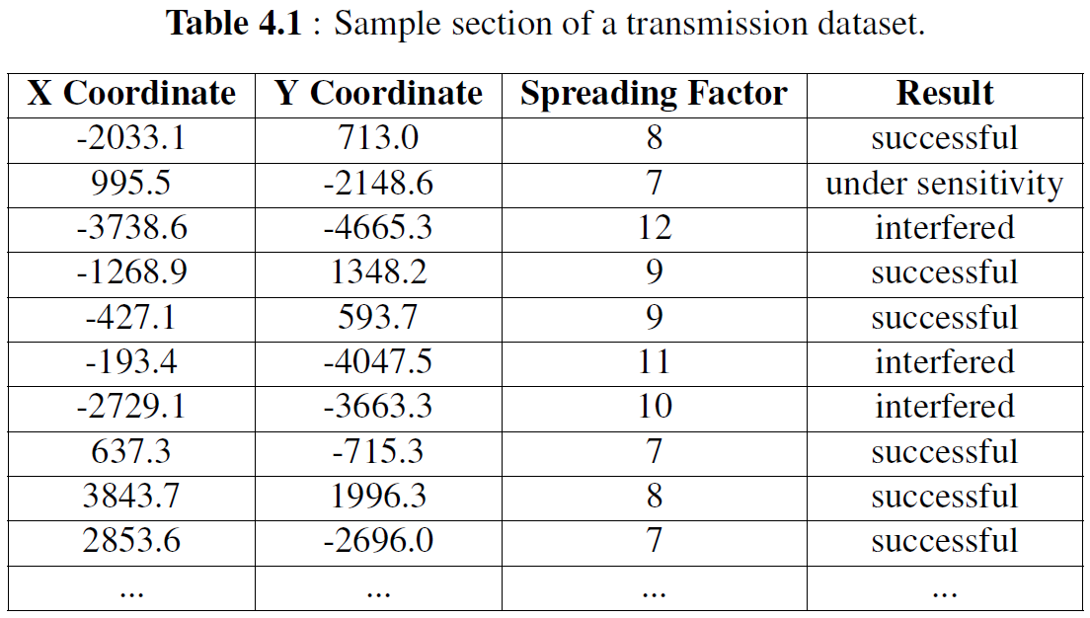
Introduction
LoRa
Related Works
Proposed Technique
Simulation Environment
Simulation Results
Conclusion
Proposed Technique
NS can keep track of transmission logs:
Location
X and Y coordinates (by triangulation)
SF
Transmission result
Successful
Interfered
Under sensitivity
Notes:
In this approach, NS can keep track of transmission logs with
Transmission location. This can be obtained by triangulation
Spreading factor
And transmission results. Possible transmission results are
Successful
Interfered
And under sensitivity
You can see sample section of transmission logs

Slide 20
Introduction
LoRa
Related Works
Proposed Technique
Simulation Environment
Simulation Results
Conclusion
Proposed Technique
NS can train a classifier to predict future transmission result for a specific location and a specific SF
Using this prediction model NS can assign SFs to nodes considering prediction of transmissions
NS can modify SF of a node using existing ADR mechanism
No change required on LoRaWAN protocol
Every end node makes at least one uplink transmission in a day
At least one open receive window every day to inform end nodes about new spreading factor
Notes:
Using those obtained information, NS can train a classifier to predict future transmission result for a specific node and a specific spreading factor
Using this prediction model NS can assign spreading factors to nodes considering the collision probability.
NS can modify spreading factor of the node using existing ADR mechanism.
Thus, this technique does not require any modification on LoRaWAN protocol.
It is fair enough to assume that every end node makes at least one uplink transmission in a day
so there is at least one open receive window every day to inform end nodes about new spreading factor.
ns cannot just ask end nodes to change spreading factor at any time, ns needs to wait a uplink transmission

Slide 21
Introduction
LoRa
Related Works
Proposed Technique
Simulation Environment
Simulation Results
Conclusion
Proposed Technique
Decision tree classifier (DTC) and support vector machine (SVM) machine learning methods are employed
Mass amount of LoRaWAN transmission logs can be generated using developed simulation tool
A classifier is trained from generated dataset and this classifier is used for selecting optimum SF for the nodes
NS can create a classifier daily basis
Gateways can inform nodes to use suggested SF
Notes:
In this work, decision tree classifier and support vector machine methods are employed to predict the transmission results
It is possible to generate mass amount of LoRaWAN transmission logs for various topologies using our simulator.
A classifier is trained from generated dataset and this classifier is used for selecting optimum spreading factor for the nodes
Network server can create a classifier daily basis
Gateways can inform nodes about to use new spreading factors

Slide 22
Introduction
LoRa
Related Works
Proposed Technique
Simulation Environment
Simulation Results
Conclusion
Proposed Technique: Simulation
The tool first runs a simulation with random SF scheme
Transmission logs are combined to create the training dataset
The dataset is fed to DTC or SVM classifiers for training
Second simulation is run with the trained classifier
The tool selects optimum SF for transmissions considering transmission predictions
Notes:
The tool first runs a simulation with random spreading factor scheme.
After random spreading factor scheme simulation completed, transmission logs are combined into three feature columns one class label column
Then, the dataset is fed to DTC or SVM classifiers for training phase.
Then, Second simulation is run with the trained classifier.
The tool selects optimum spreading factor for transmissions considering transmission predictions

Slide 23
Introduction
LoRa
Related Works
Proposed Technique
Simulation Environment
Simulation Results
Conclusion
Proposed Technique: Simulation
For every transmission:
The classifier predicts the transmission result for the lowest possible SF
If the transmission result is predicted as interfered
increase SF
predict a new transmission result
If new transmission result is classified as successful
continue to execute with selected SF
If no SF transmission result is predicted as successful
select the lowest possible SF
continue to execute
Notes:
For every transmission
the classifier predicts the transmission result for the lowest possible SF
If the transmission result is predicted as interfered, then the tool increases the spreading factor and predicts a new transmission result
If the new transmission result is classified as successful, then simulator continues to execute with selected spreading factor
If no spreading factor transmission result is predicted as successful, then the tool selects the lowest possible spreading factor again and continue to execute.

Slide 24
Introduction
LoRa
Related Works
Proposed Technique
Simulation Environment
Simulation Results
Conclusion
Simulation Environment
A discrete event simulation tool is developed to study the effects of various SF strategies for LoRaWANs
Python
From scratch
Open source
Capabilities
LoRaWAN Class A only
Uplink transmission only
Notes:
For this work a discrete event simulator is developed from scratch in Python to study the effects of various spreading factor strategies
The tool source code is open source and available at GitHub
Simulator only supports LoRaWAN Class A end devices
Since Class A behaviour is the default operation mode and provides the lowest power consumption.
Downlink transmissions are not considered. Since they are rare in real world deployments because of ISM band regulations dictate duty cycle transmission limit for all devices including gateways

Slide 25
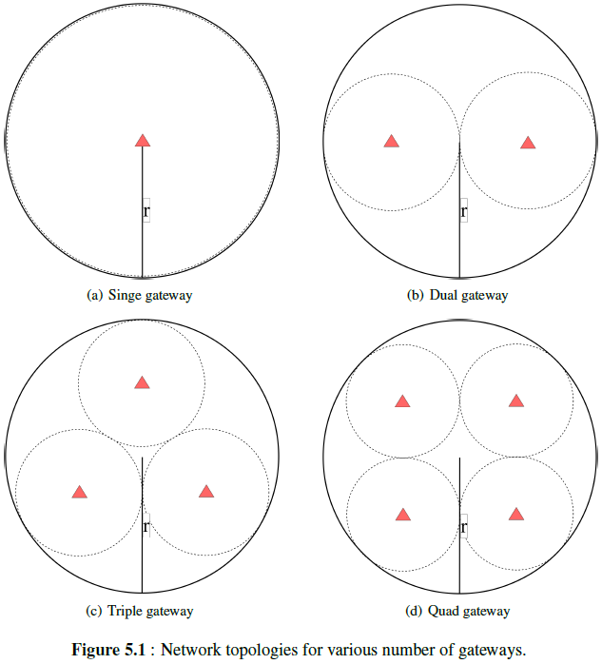
Introduction
LoRa
Related Works
Proposed Technique
Simulation Environment
Simulation Results
Conclusion
Simulation Environment: Inputs
Simulation topology inputs:
radius (m)
number of nodes
number of gateways
Notes:
Simulator can generate uniformly distributed circular shape network topology with input parameters:
radius in meter,
number of nodes
and number of gateways.
The tool first distributes gateways
Then, randomly places end nodes in network radius.

Slide 26
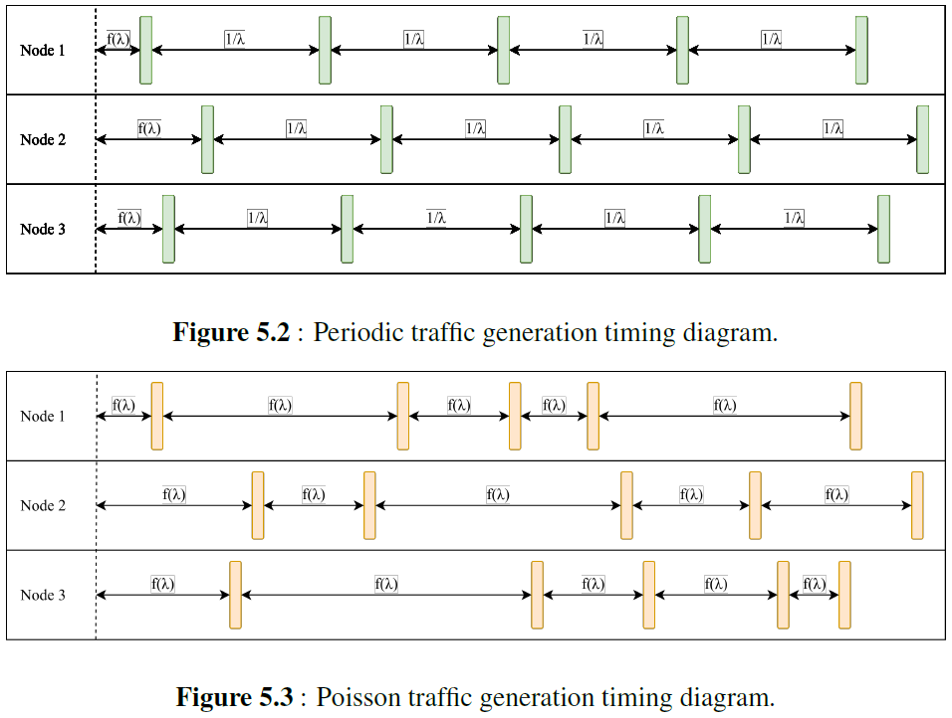
Introduction
LoRa
Related Works
Proposed Technique
Simulation Environment
Simulation Results
Conclusion
Simulation Environment: Inputs
Simulation inputs:
simulation duration (s)
packet size (B)
packet generation rate (pps)
SF assignment method
packet generation type
Notes:
Global simulation input parameters are
simulation duration in second
packet size in Byte
packet generation rate in packets per second
spreading factor assignment method
And packet generation type which can be
Periodic and Poisson
Initial transmission intervals are always generated by Poisson.
to prevent continuous collisions between periodic transmissions

Slide 27
Introduction
LoRa
Related Works
Proposed Technique
Simulation Environment
Simulation Results
Conclusion
Simulation Environment: Outputs
Simulation outputs:
number of generated packets
number of successfully received packets
number of interfered packets
number of under sensitivity packets
network packet delivery ratio percentage
network throughput (bps)
total transmit energy consumption (J)
Notes:
With these inputs the simulator produces
number of generated packets
number of successfully received packets
number of interfered packets
number of under sensitivity packets
Network packet delivery ratio percentage,
network throughput in bits per second
and total transmit energy consumption in Joule
Simulator also produces prediction accuracy percentage and confusion matrix for machine learning schemes.

Slide 28

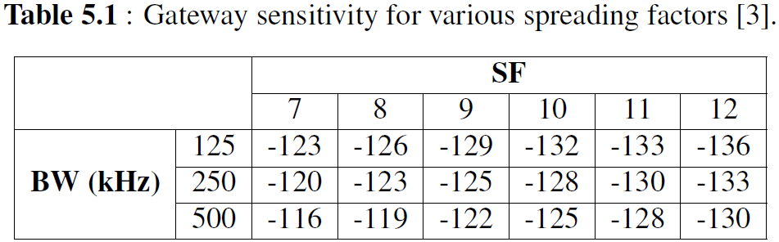
Introduction
LoRa
Related Works
Proposed Technique
Simulation Environment
Simulation Results
Conclusion
Simulation Environment: Link Model
Link quality of a wireless system [17]:
Sum of system gains and system losses is assumed as +7 dB
All transmissions use maximum allowed transmit power 14 dBm
Notes:
Link quality of a wireless system can be expressed by the link budget
Link budget can be calculated by this formula where
PRX is the expected receive power at the receiver
PTX is the transmit power of the transmitter
G SYS is the system gains such as transmitter and receiver antenna gains
L SYS is the system losses such as transmitter and receiver line, circuit, antenna losses
L PATH is the propagation path loss between transmitter and receiver antennas in open space
it is assumed that sum of system gains and system losses is +7 dB
it is assumed that nodes always select maximum allowed transmit power, which is 14 dBm.
If the received signal power is higher than the gateway sensitivity,
then signal can be decoded by the receiver successfully when there is no interfering transmission.

Slide 29

Introduction
LoRa
Related Works
Proposed Technique
Simulation Environment
Simulation Results
Conclusion
Simulation Environment: Link Model
Free space propagation loss [32]:
Assume h = 15 m and f = 868 MHz
Notes:
Free space propagation loss is calculated as
Where h is the gateway altitude and f is the frequency of the signal,
It is assumed that gateway altitude is 15 m and frequency is 868 MHz which is European ISM band frequency
With these assumptions, propagation loss calculation become

Slide 30
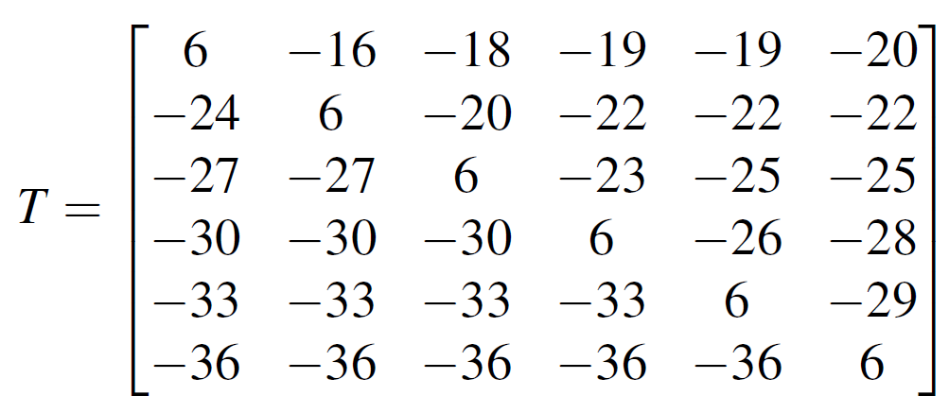
Introduction
LoRa
Related Works
Proposed Technique
Simulation Environment
Simulation Results
Conclusion
Simulation Environment: Interference Model
It is assumed that there is no other technology interference
Simulator calculates the effect of different SF transmissions to each other
Signal to interference plus noise ratio threshold matrix [33]:
Margin between referenced signal and interfering signal to correctly decode the referenced signal
Notes:
In this work, it is assumed that there is no other technology interference in the network except LoRa interference
Simulator calculates the effect of different spreading factor transmissions to each other
signal to interference plus noise ratio threshold matrix is adopted
Where T ij is margin between referenced signal with SF = i and interfering signal with SF = j to correctly decode the referenced signal

Slide 31
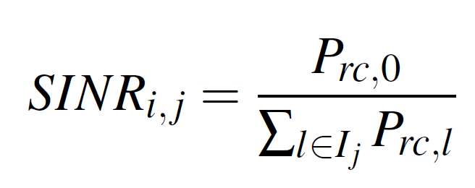
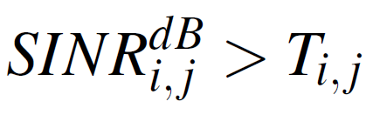
Introduction
LoRa
Related Works
Proposed Technique
Simulation Environment
Simulation Results
Conclusion
Simulation Environment: Interference Model
If there are more than one interfering signal
Cumulative sum of all interfering signal received power for each SF
SINR threshold can be calculated
Packet survives from all interferences if:
Notes:
If there are more than one interfering signal, referenced signal must satisfy the margin for sum of all interfering signal received power for each spreading factor
SINR threshold can be calculated by this equation
Where Prc,0 is received signal power of referenced signal
Prc,l is received signal power of interfering signal for SF = j.
If a packet with SF = i satisfies the following condition for every SF = j, then packet is survived from all interferences.

Slide 32
Introduction
LoRa
Related Works
Proposed Technique
Simulation Environment
Simulation Results
Conclusion
Simulation Environment: Software
Tool keeps an event queue
Every event is a transmission
Every transmission has
Time
SF
Source
Duration
Status
Simulation steps:
Every node generates an event according to their traffic generation rate
Initially all events are in pending state
Tool executes events
Tool marks events statuses as transmitted, interfered or under sensitivity
Tool calculates network PDR, throughput and transmit energy consumption
Example CLI command:
python3 main.py -r 7000 -g 3 -n 300 -s SF_Lowest -d 3600
Notes:
The tool keeps a transmission queue
Every event in this queue is a transmission
Every transmission has
time
spreading factor
source
Duration
and status fields
First
Every end node generates an event according to their traffic generation rate and inserts this event to event queue.
Initially all events are in pending state
Tool executes events one by one
Tool marks events statuses as transmitted, interfered or under sensitivity
Finally tool calculates network PDR, throughput and transmit energy consumption
A command line parser is developed for interacting with the tool, so the tool can be run without any programming or scripting
Example tool command is below

Slide 33
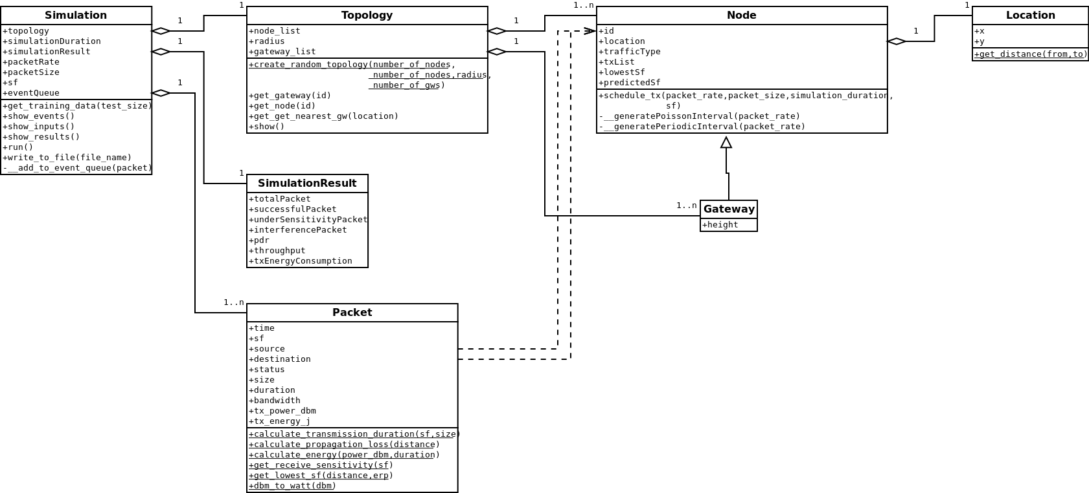
Introduction
LoRa
Related Works
Proposed Technique
Simulation Environment
Simulation Results
Conclusion
Simulation Environment: Software
Notes:
Simulation class is the core class of the simulator.
Event queue is in this class and packet class is the instances of this queue
Every simulation instance has topology instance and every topology instance has several node and gateway objects

Slide 34
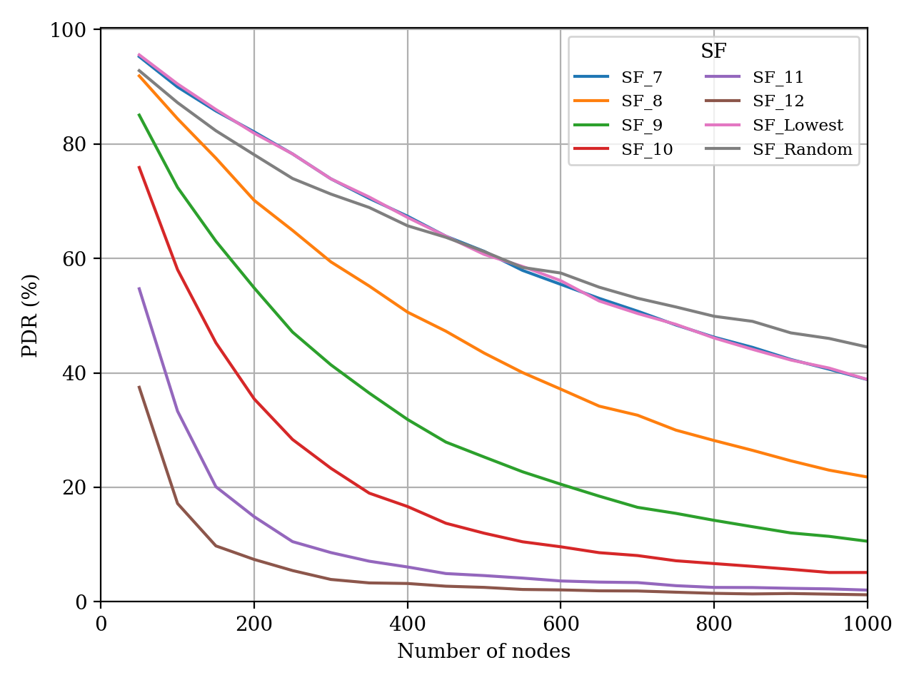
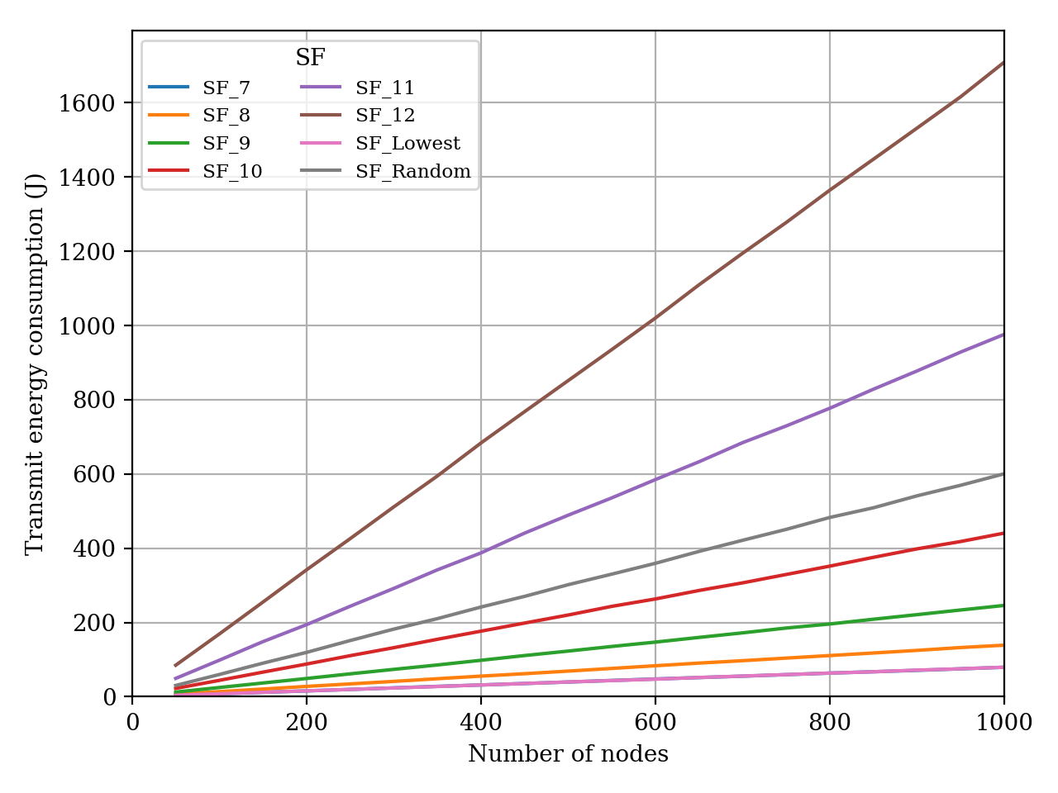
Introduction
LoRa
Related Works
Proposed Technique
Simulation Environment
Simulation Results
Conclusion
Simulation Results: Single Gateway
(a) PDR
(b) Transmit energy
Figure 6.1 : PDR plot for various spreading factors. (r = 3000 m, GW = 1, R_{t} = 0.01 pps)
Notes:
For the remaining simulation results presented:
packet size is set to 60 Bytes
traffic generation type is set as Poisson
First, I will present single gateway and multiple gateway simulation results to show correctness of the simulator then I will present smart spreading factor simulation results
Here PDR and transmit energy consumption plots of various spreading factor assignment schemes are shown
Increasing spreading factors, increases time on air
This increases the number of collisions thus decreases the PDR
Also, increasing spreading factors increases total transmit energy consumption as expected
High spreading factors gives poor PDR results as the number of nodes increases

Slide 35
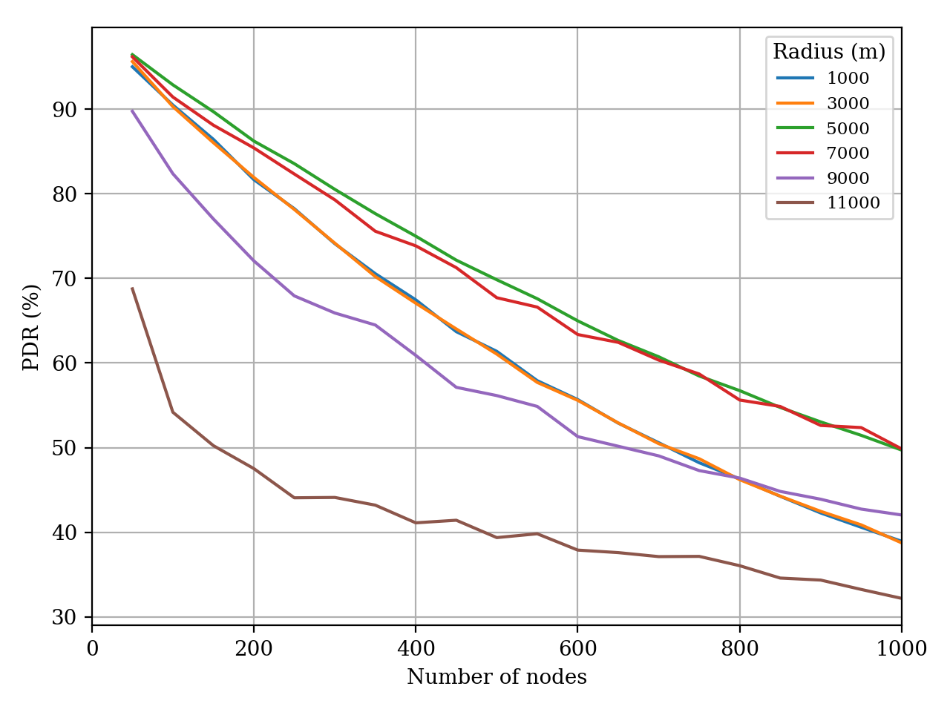
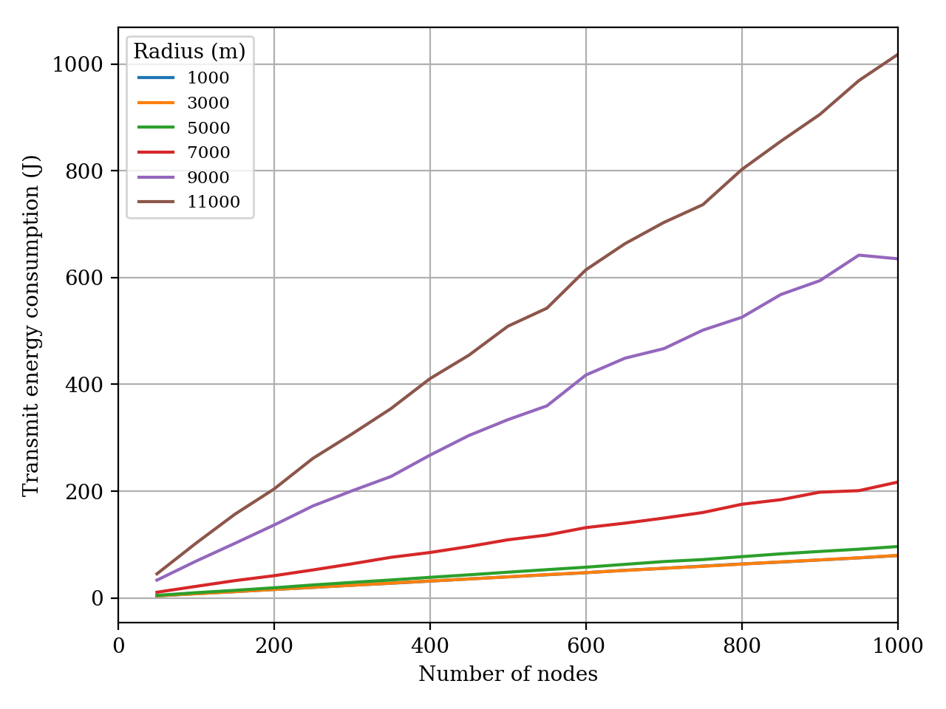
Introduction
LoRa
Related Works
Proposed Technique
Simulation Environment
Simulation Results
Conclusion
Simulation Results: Single Gateway
(a) PDR
(b) Transmit energy
Figure 6.2 : PDR plot for various spreading radii. (GW = 1, SF = SF_Lowest, R_{t} = 0.01 pps)
Notes:
plots for various network radii are shown
lowest spreading factor assignment scheme is used for these plots
Increasing network radius,
increases the number of under sensitivity transmissions
thus decreases the PDR
Nodes select higher spreading factors when they are far away from the gateway.
Thus, higher spreading factor leads to
longer air time,
higher number of collisions
and higher total transmit power consumption

Slide 36
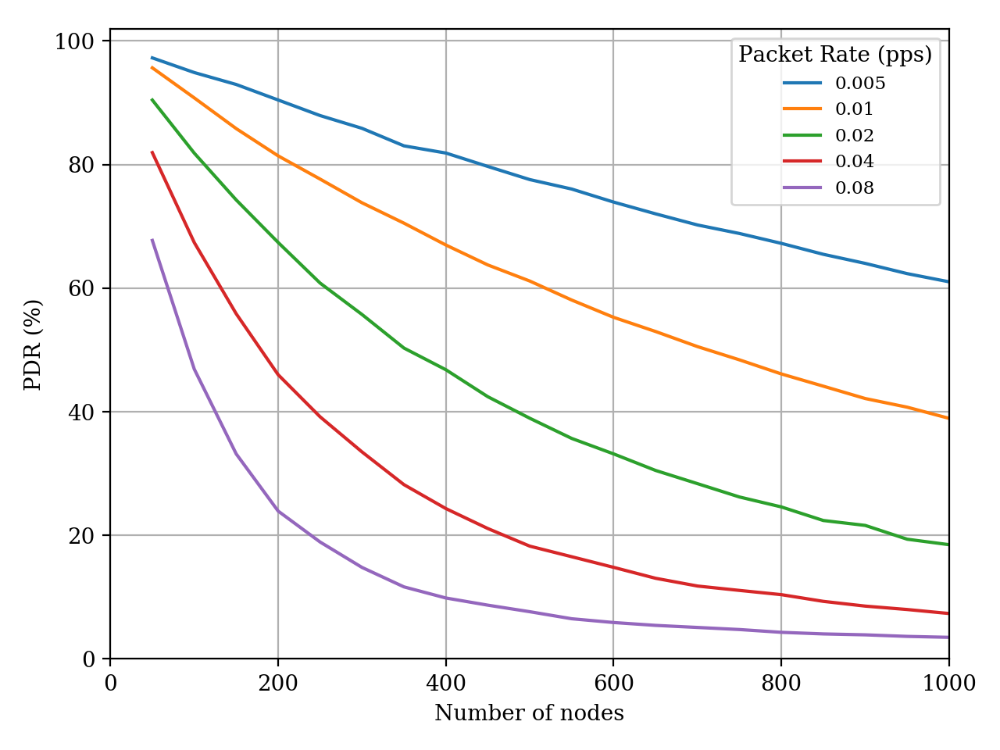
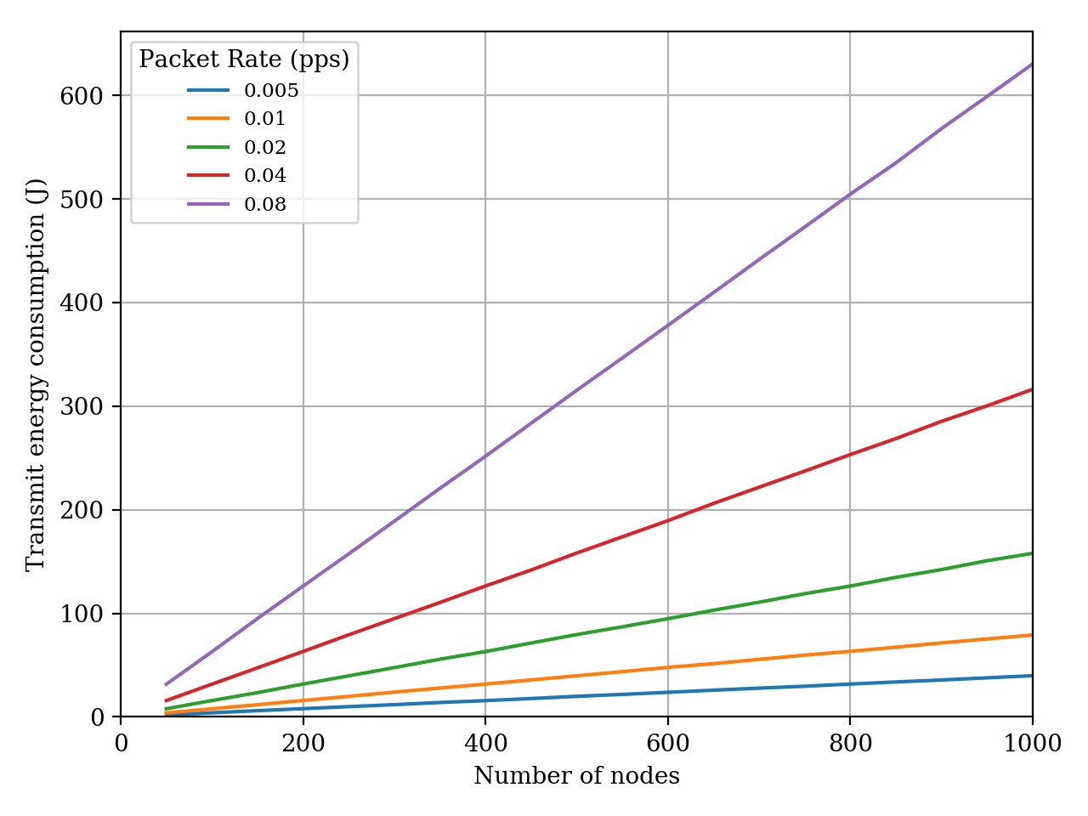
Introduction
LoRa
Related Works
Proposed Technique
Simulation Environment
Simulation Results
Conclusion
Simulation Results: Single Gateway
(a) PDR
(b) Transmit energy
Figure 6.3 : PDR plot for various packet generation rates. (r = 3000 m, GW = 1, SF = SF_Lowest)
Notes:
plots for various packet generation rate are shown
Increasing packet generation rate,
increases air time
thus increases number of collisions,
decreases PDR
and increases transmit power consumption
Doubling packet generation rate doubles total transmit power consumption

Slide 37
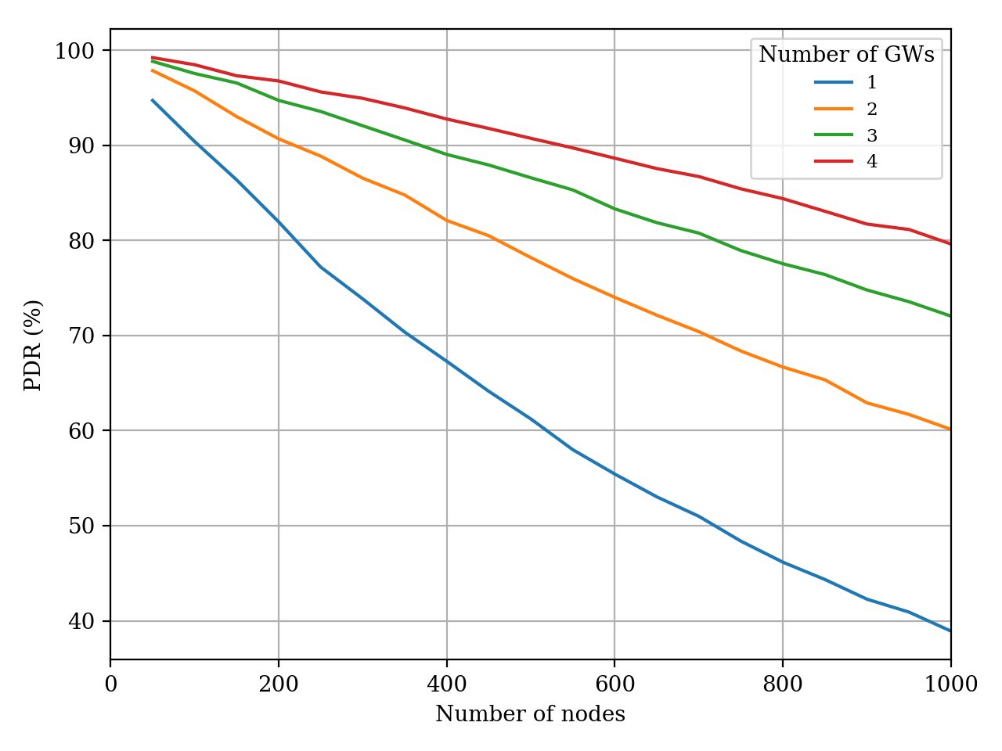
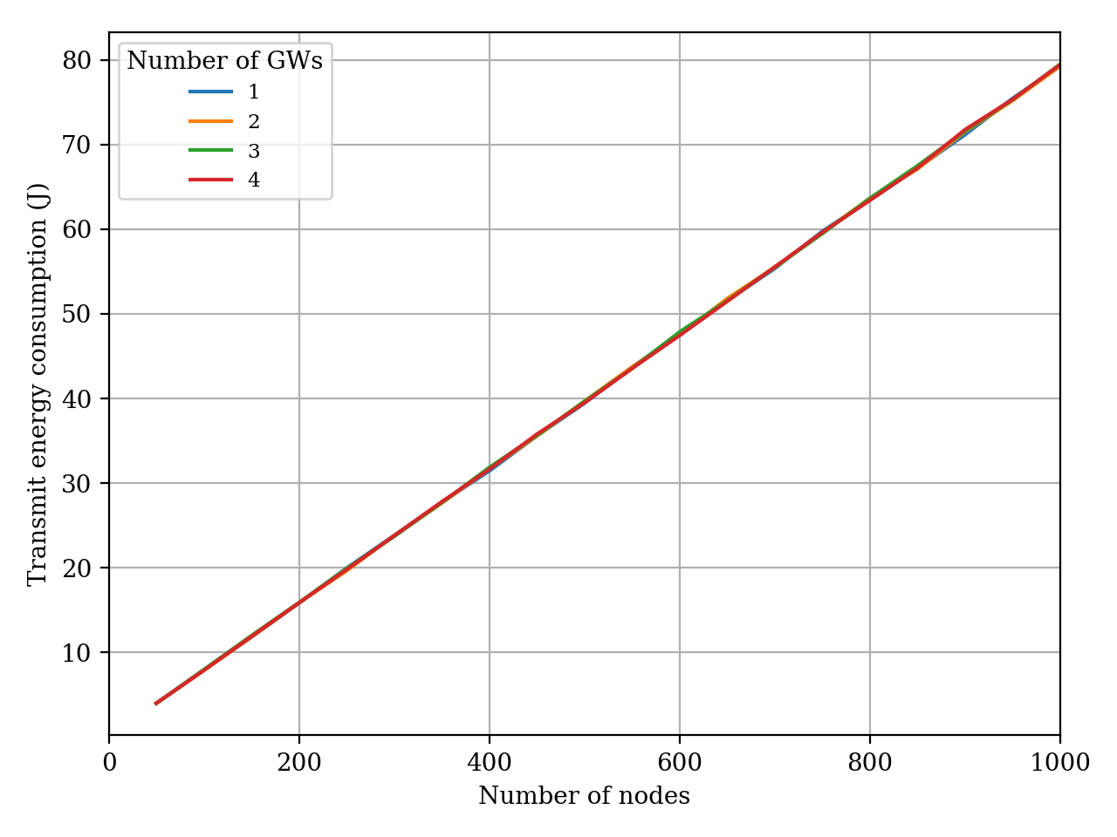
Introduction
LoRa
Related Works
Proposed Technique
Simulation Environment
Simulation Results
Conclusion
Simulation Results: Multiple Gateway
(a) PDR
(b) Transmit energy
Figure 6.4 : PDR plot for various number of gateways. (r = 3000 m, SF = SF_Lowest, R_{t} = 0.01 pps)
Notes:
plots for various number of gateways are shown
Increasing number of gateways in constant topology radius,
decreases the distance between nodes and gateways
Thus, decreases the number of collisions at gateways
Hence, increases the PDR.
Since topology radius is small, most of the end nodes selects lowest spreading factor all the time
Thus air time is same and total transmit power consumption is same for all plots

Slide 38
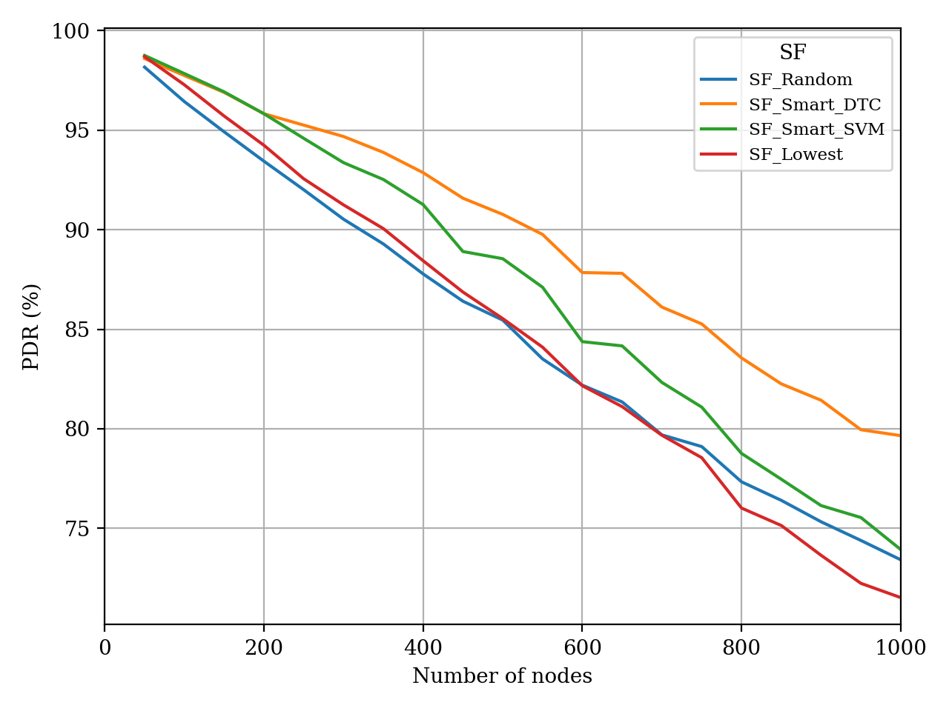
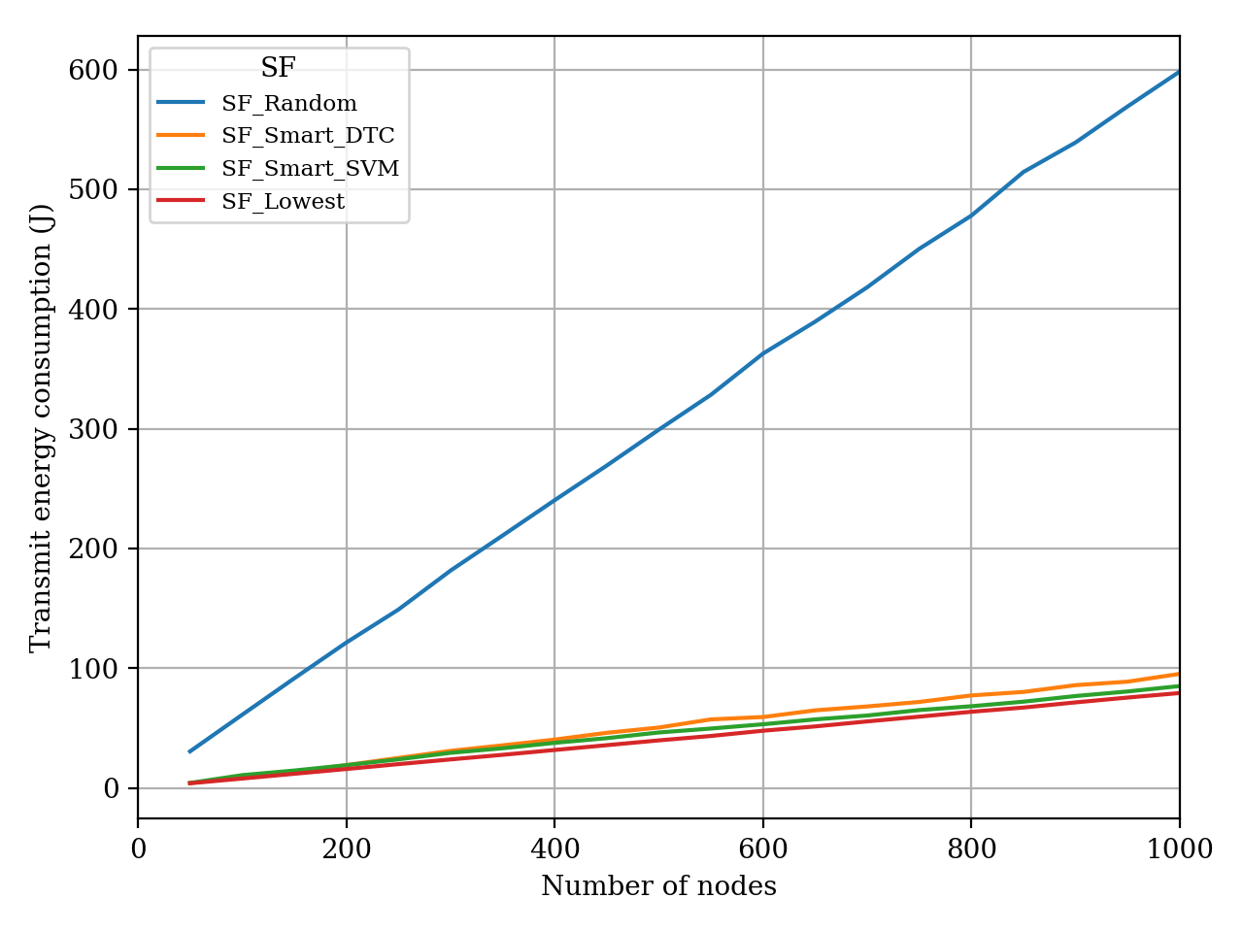
Introduction
LoRa
Related Works
Proposed Technique
Simulation Environment
Simulation Results
Conclusion
Simulation Results: Smart SF Schemes
(a) PDR
(b) Transmit energy
Figure 6.5 : PDR plot for lowest and smart spreading factor schemes. (r = 5000 m, GW = 3, R_{t} = 0.01 pps)
Notes:
Finally plots for the smart spreading factor schemes are shown, these plots are main objective and main results of this work
network radius is set to 5000 meters, number of gateways is set to 3
Prediction model needs nodes' locations and three gateways are enough to locate position of nodes by triangulation.
Both smart SVM and smart DTC schemes give better PDR than lowest spreading factor schemes when number of nodes increases.
Increasing number of nodes, increases number of interferences.
Smart schemes can only improve network performance when LoRa interference is high.
Moreover, smart schemes give better results when nodes are deployed closer to the gateway, since nodes have margin to increase their spreading factors when they are deployed closer to the gateway
If a node is far away from gateway, then smart schemes cannot increase the spreading factor to avoid interference since the assigned spreading factor is already high.
As number of nodes increases, both smart SVM and smart DTC schemes consume slightly more energy than lowest spreading factor scheme,
however they give better PDR results in return
Random spreading factor scheme consumes much higher transmit power than the rest.

Slide 39
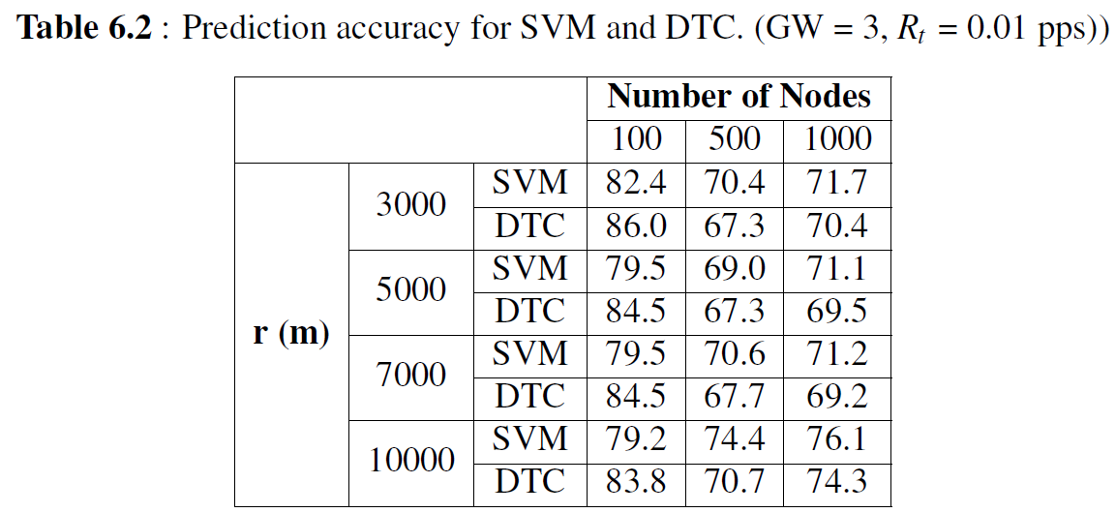
Introduction
LoRa
Related Works
Proposed Technique
Simulation Environment
Simulation Results
Conclusion
Simulation Results
Prediction accuracy is not directly proportional to network PDR
Correct prediction of an interfered transmission may not increase the PDR but increases the prediction accuracy
Notes:
prediction accuracy of smart SVM and smart DTC schemes are presented for various network radii and number of nodes.
Prediction accuracy is not directly proportional to network PDR
Correct prediction of an interfered transmission may not increase the PDR but increases the prediction accuracy
Smart DTC gives better network PDR results than smart SVM, even overall smart SVM prediction accuracy is higher
The distribution of different labeled data points in the dataset is strongly related to simulation parameters.
If simulation is run with small topology radius and high number of nodes, then number of interfered transmission labeled data points increases.
On the other hand, using a large topology radius in the simulation causes the number of under sensitivity transmission labeled data points to increase.
Moderately dense network parameters are chosen to make it closer to real world deployments.
With the simulation parameters utilized in this section, simulation tool usually produces imbalanced dataset.
Number of under sensitivity transmission labeled data points are less than number of successful transmission labeled data points.
Besides, number of interfered transmission labeled data points are even less than number of under sensitivity transmission labeled data points. In this case, smart DTC predicts interfered transmission labeled data points more accurately.
Correct classification of interfered transmissions yields better network PDR results, thus smart DTC scheme gives better network PDR results.

Slide 40
Introduction
LoRa
Related Works
Proposed Technique
Simulation Environment
Simulation Results
Conclusion
Conclusion
SF assignment on network performance is investigated in detail
Factors that increase the number of collisions are evaluated
Measures that can be taken to reduce collisions are described
A discrete event simulator is developed from scratch to study SF assignment strategies
A novel method which utilizes machine learning techniques is proposed
Simulation results show smart SF methods provide promising network performance improvements especially for dense LoRaWAN networks
Notes:
To summarize, in this work
Spreading factor assignment on network performance is investigated in detail
Factors that increase the number of collisions are evaluated
Measures that can be taken to reduce collisions are described
A discrete event simulator is developed from scratch to study Spreading factor assignment strategies
A novel method which utilizes machine learning techniques is proposed
Simulation results show smart Spreading factor methods provide promising network performance improvements especially for dense LoRaWAN networks

Slide 41
Introduction
LoRa
Related Works
Proposed Technique
Simulation Environment
Simulation Results
Conclusion
Conclusion
As for future work
Transmit power optimization
Class B and Class C end node behavior
Other machine learning methods such as reinforcement learning
Other transmission parameters such as node id and transmission time can be included
Summary of this work is accepted to ISCC 2019 Barcelona, Spain
Yatagan, T. and Oktug S., 2019, Smart Spreading Factor Assignment for LoRaWANs, 2019 IEEE Symposium on Computers and Communications (IEEE ISCC 2019)
Notes:
As for future work,
transmit power optimization can be included to the proposed smart schemes
In this thesis, it is assumed that nodes always use maximum transmit power for uplink transmission, however nodes close to gateways can decrease transmit power to save energy
it is also assumed that only LoRaWAN Class A end nodes are present, however Class B and Class C end node behavior can be integrated to check how extra downlink communication effects smart SF schemes
Moreover, other machine learning methods can be investigated. Reinforcement learning could be a good candidate.
Also, other transmission parameters such as node id and transmission time can be included to the proposed scheme in order to improve prediction performance
Lastly summary paper of this work is accepted to IEEE ISCC 2019 and will be presented in Barcelona, Spain at Second of July

Slide 42
Notes:
Thank you for your attention.

Slide 43
References
European Telecommunications Standards Institute (2018). Electromagnetic compatibility and Radio spectrum Matters (ERM); Short Range Devices (SRD); Radio equipment to be used in the 25 MHz to 1 000 MHz frequency range with power levels ranging up to 500 mW EN 300 220-1 V2.4.1, Technical Report, European Telecommunications Standards Institute, Sophia Antipolis, France, https://www.etsi.org/deliver/etsi_en/300200_300299/30022002/03.02.01_60/en_30022002v030201p.pdf [Accessed: 03-May-2019].
LoRa Alliance Technical Committee Regional Parameters Workgroup(2018). LoRaWAN 1.1 Regional Parameters v1.1rB, Technical Report, LoRa Alliance, San Ramon, California, USA, https://lora-alliance.org/sites/default/files/2018-04/lorawantm_regional_parameters_v1.1rb_-_final.pdf [Accessed: 03-May-2019].
Semtech Corporation Wireless Sensing and Timing Products Division (2019). SX1276/77/78/79 - 137 MHz to 1020 MHz Low Power Long Range Transceiver Datasheet, Technical Report, Semtech Corporation, Camarillo, California, USA, https://www.semtech.com/uploads/documents/DS_SX1276-7-8-9_W_APP_V6.pdf [Accessed: 03-May-2019].
Egli, P., (2017). LPWAN - Low Power Wide Area Networks, http://peteregli.net/content/mobile-wireless/LPWAN/LPWAN.pdf [Accessed: 03-May-2019].
Ghoslya, S., (2017), LoRa: Symbol Generation, https://www.sghoslya.com/p/lora-is-chirp-spread-spectrum.html [Accessed: 03-May-2019].
Witekio, (2018), LoRaWan, a dedicated IoT network, https://witekio.com/blog/lorawan-dedicated-iot-network [Accessed: 03-May-2019].
Sornin, N. and Yegin, A. (2017). LoRaWAN 1.1 Specification, Technical Report, LoRa Alliance, Beaverton, Oregon, USA, https://lora-alliance.org/sites/default/files/2018-04/lorawantm_specification_-v1.1.pdf [Accessed: 03-May-2019].
Centenaro, M., Vangelista, L., Zanella, A. and Zorzi, M. (2016). Long-range communications in unlicensed bands: the rising stars in the IoT and smart city scenarios, IEEE Wireless Communications, 23(5), 60–67.
Al-Fuqaha, A., Guizani, M., Mohammadi, M., Aledhari, M. and Ayyash, M. (2015). Internet of Things: A Survey on Enabling Technologies, Protocols, and Applications, IEEE Communications Surveys Tutorials, 17(4), 2347–2376.
Raza, U., Kulkarni, P. and Sooriyabandara, M. (2017). Low Power Wide Area Networks: An Overview, IEEE Communications Surveys Tutorials, 19(2), 855–873.
Finnegan, J. and Brown, S. (2018). A Comparative Survey of LPWA Networking, CoRR, abs/1802.04222.
Abramson, N. (1970). THE ALOHA SYSTEM: Another Alternative for Computer Communications, Proceedings of the November 17-19, 1970, Fall Joint Computer Conference, AFIPS ’70 (Fall), ACM, New York, NY, USA, pp.281–285, http://doi.acm.org/10.1145/1478462.1478502.
Sigfox (2017). Sigfox Technical Overview, Technical Report, Sigfox, Labège, France, https://storage.sbg1.cloud.ovh.net/v1/AUTH_669d7dfced0b44518cb186841d7cbd75/dev_medias/build_technicalOverview.pdf [Accessed: 03-May-2019].
Georgiou, O. and Raza, U. (2017). Low Power Wide Area Network Analysis: Can LoRa Scale?, IEEE Wireless Communications Letters, 6(2), 162–165.
Semtech Corporation, Semtech Corporation Website, https://www.semtech.com [Accessed: 03-May-2019].
Berni, A. and Gregg, W. (1973). On the Utility of Chirp Modulation for Digital Signaling, IEEE Transactions on Communications, 21(6), 748–751.
Semtech Corporation Wireless Sensing and Timing Products Division (2015). LoRaTM Modulation Basics AN1200.22, Technical Report, Semtech Corporation, Camarillo, California, USA, https://www.semtech.com/uploads/documents/an1200.22.pdf [Accessed: 03-May-2019].

Slide 44
References
Adelantado, F., Vilajosana, X., Tuset-Peiro, P., Martinez, B., Melia-Segui, J. and Watteyne, T. (2017). Understanding the Limits of LoRaWAN, IEEE Communications Magazine, 55(9), 34–40.
LoRa Alliance, LoRa Alliance Website, https://lora-alliance.org [Accessed: 03-May-2019].
Magrin, D., Centenaro, M. and Vangelista, L. (2017). Performance evaluation of LoRa networks in a smart city scenario, 2017 IEEE International Conference on Communications (ICC), pp.1–7.
Van den Abeele, F., Haxhibeqiri, J., Moerman, I. and Hoebeke, J. (2017). Scalability Analysis of Large-Scale LoRaWAN Networks in ns-3, IEEE Internet of Things Journal, 4(6), 2186–2198.
Croce, D., Gucciardo, M., Mangione, S., Santaromita, G. and Tinnirello, I. (2018). Impact of LoRa Imperfect Orthogonality: Analysis of Link-Level Performance, IEEE Communications Letters, 22(4), 796–799.
Mahmood, A., Sisinni, E., Guntupalli, L., Rondón, R., Hassan, S.A. and Gidlund, M. (2018). Scalability Analysis of a LoRa Network under Imperfect Orthogonality, IEEE Transactions on Industrial Informatics, 1–1.
Cuomo, F., Campo, M., Caponi, A., Bianchi, G., Rossini, G. and Pisani, P. (2017). EXPLoRa: Extending the performance of LoRa by suitable spreading factor allocations, 2017 IEEE 13th International Conference on Wireless and Mobile Computing, Networking and Communications (WiMob), pp.1–8.
Haxhibeqiri, J., Van den Abeele, F., Moerman, I. and Hoebeke, J. (2017). LoRa Scalability: A Simulation Model Based on Interference Measurements, Sensors, 17(6), http://www.mdpi.com/1424-8220/17/6/1193.
Slabicki, M., Premsankar, G. and Di Francesco, M. (2018). Adaptive configuration of lora networks for dense IoT deployments, NOMS 2018 - 2018 IEEE/IFIP Network Operations and Management Symposium, pp.1–9.
Semtech Corporation (2016). LoRaWAN – simple rate adaptation recommended algorithm, Technical Reportv1.0, Semtech Corporation, Camarillo, California, USA.
The Things Network, (2018), LoRaWAN Adaptive Data Rate, https://www.thethingsnetwork.org/docs/lorawan/adr.html [Accessed: 03-May-2019].
Alpaydin, E. (2010). Introduction to Machine Learning, The MIT Press, 2nd edition.
Yatagan, T., (2019), tugrulyatagan/simlorasf, https://doi.org/10.5281/zenodo.3072925 [Accessed: 03-May-2019].
Yates, R.D. and Goodman, D.J. (2014). Probability and Stochastic Processes: A Friendly Introduction for Electrical and Computer Engineers, Wiley, 3rd edition.
European Telecommunications Standards Institute (2016). Radio Frequency (RF) system scenarios TR 136 942 V13.0.0, Technical Report, European Telecommunications Standards Institute, Sophia Antipolis, France, https://www.etsi.org/deliver/etsi_tr/136900_136999/136942/13.00.00_60/tr_136942v130000p.pdf [Accessed: 03-May-2019].
Goursaud, C. and Gorce, J.M. (2015). Dedicated networks for IoT : PHY / MAC state of the art and challenges, EAI endorsed transactions on Internet of Things, https://hal.archives-ouvertes.fr/hal-01231221.
Python Software Foundation, Python Downlaod Website, https://www.python.org/downloads [Accessed: 03-May-2019].

